Slide 1




From raw images to preprocessed data
Alex Sánchez
Statistics and Bioinformatics Research Group
Statistics department, Universitat de Barelona
Statistics and Bioinformatics Unit
Vall d’Hebron Institut de Recerca

Slide 2
Outline
What do sequencing technologies produce
NGS data formats. Sequence files formats
What problems may there be?
Error sources and error models
Detecting errors
Quality control of NGS data
Adjusting errors
Post-processing of sequence data
Conclusions and perspectives

Slide 3
Data and data formats

Slide 4
One input, many possible outputs …

Slide 5
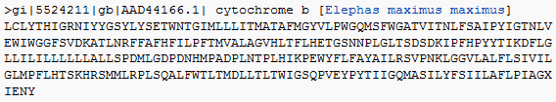
Typical Sequence Data Formats(I)
All Sequence formats are ASCII text containing sequence ID, Quality Scores, Annotation details, comments, and other descriptions about sequence
Formats are designed to hold sequence data and other information about sequence
FastA format (everybody knows about it)
Header line starts with “>” followed by a sequence ID
Sequence (string of nt).

Slide 6
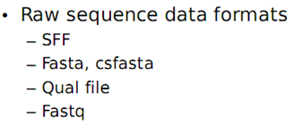
Why so many formats?
Created based on the information required for each step of analysis
Efficient Data & time management
Each Data formats vary in the information they contain
Types of sequence file formats
Raw Sequence files
Co-ordinate files
Parameter files
Annotation files
Metadata files

Slide 7
Read output formats
454
Solexa/Illumina
SOLiD

Slide 8
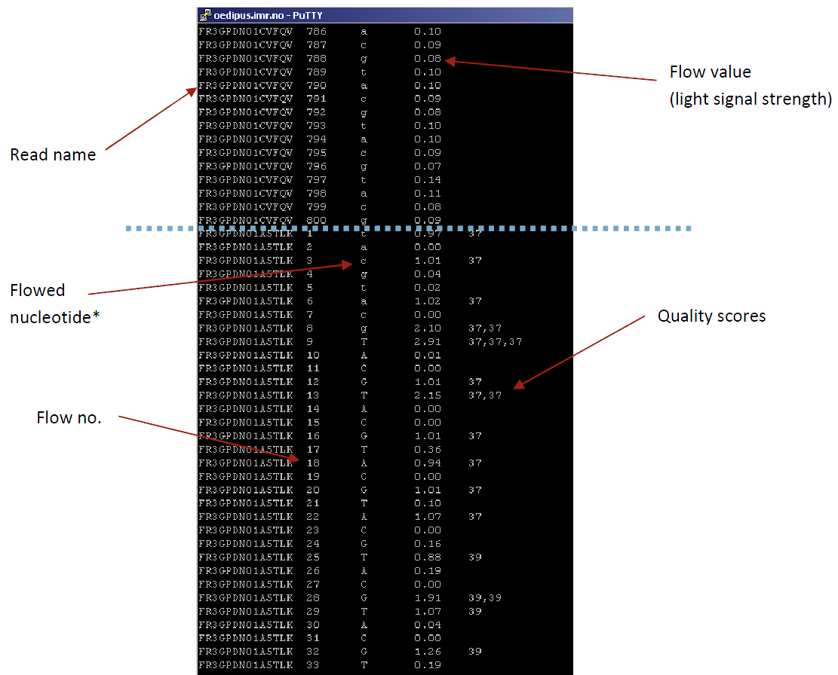
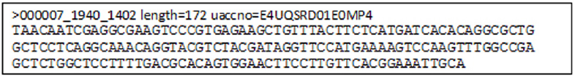
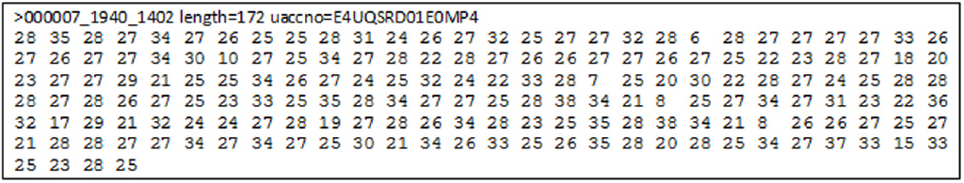
454 output formats
Standard flowgram format
.sff
.fna
.qual
Notes:
Sequencers use their own output formats, and even multiple different formats per technology.
Output formats from Roche 454 sequencers:
.sff is 454’s binary(=compressed) format, including the raw data. Not the very raw images, but flow values (flowgram), base calls, base-call qualities, read trimming and quality.
There are many simple tools that “unzip” .sff into some readable textual format (see the black example).
.fna is a FASTA (or FASTA-like) format including the base-called reads.
.qual includes qualities corresponding to bases in .fna.

Slide 9
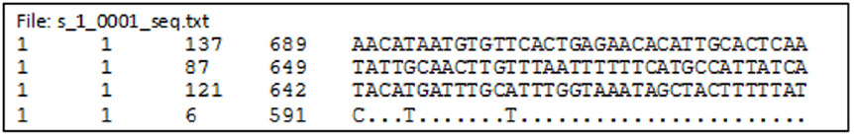
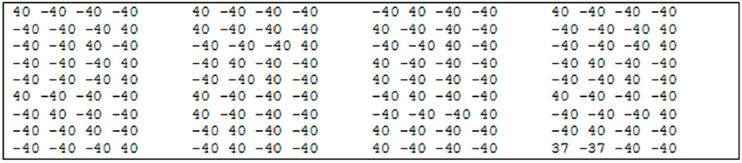
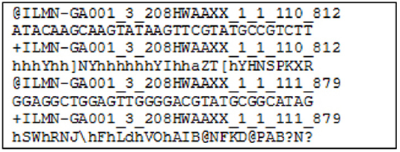
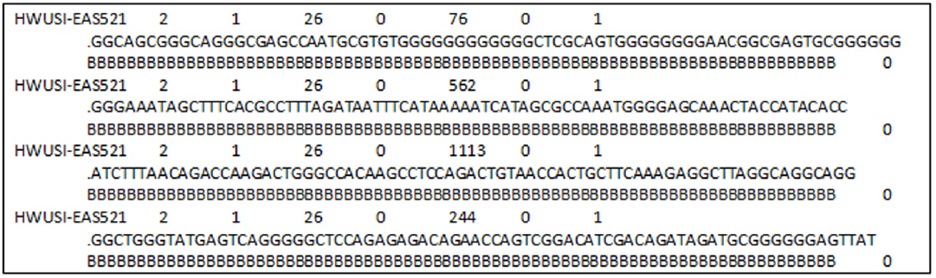
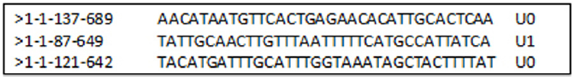
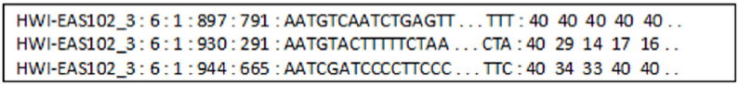
Illumina output formats
.seq.txt
.prb.txt
Illumina FASTQ (ASCII – 64 is Illumina score)
Qseq
(ASCII – 64 is Phred score)
Illumina single line format
SCARF
Phred quality scores
Solexa Compact ASCII Read Format
Notes:
Illumina is over-creative with their own formats.
.seq.txt: base-called sequences
.prb.txt: qualities for each nucleotide/each cycle (is some kind of semi-raw data?)
Illumina FASTQ is not real FASTQ, but looks similarly (to cause confusion). The quality score is an own Illumina score, computed by subtracting 64 from the ASCII code of the character. For example the ‘h’ in the example is ord(‘h’) – 64 = 104 – 64 = 40.
See http://www.asciitable.com/ for ASCII codes (Dec is the ‘ord’ in decimal numbers).
The Illumina score can be transformed to Phred score. Given a character ch, the following expression should give the Phred quality q (please double-check:) q = 10 * log(1 + 10 ^ (ord(ch) - 64) / 10.0)) / log(10)
Qseq: Not looking like FASTQ, but the scores are proper Phred scores. Their encoding is however still ASCII – 64.
Illumina “single line format” and SCARF: base-called sequences and quality scores in a bit more handy format.

Slide 10
Typical Sequence Data formats (2)
FastQ format (http://maq.sourceforge.net/fastq.shtml)
First is the sequence (like Fasta but starting with “@”)
Then “+” and sequence ID (optional) and in the following line are QVs encoded as single byte ASCII codes
Different quality encode variants
Nearly all downstream analysis take FastQ as input sequence

Slide 11
The fastq format
A FASTQ file normally uses four lines per sequence.
Line 1 begins with a '@' character and is followed by a sequence identifier and an optional description (like a FASTA title line).
Line 2 is the raw sequence letters.
Line 3 begins with a '+' character and isoptionally followed by the same sequence identifier (and any description) again.
Line 4 encodes the quality values for the sequence in Line 2, and must contain the same number of symbols as letters in the sequence.
Different encodings are in use
Sanger format can encode a Phred quality score from 0 to 93 using ASCII 33 to 126
@Seq description
GATTTGGGGTTCAAAGCAGTATCGATCAAATAGTAAATCCATTTGTTCAACTCACAGTTT
+
!''*((((***+))%%%++)(%%%%).1***-+*''))**55CCF>>>>>>CCCCCCC65

Slide 12
Phred Scores
Sequencing systems use to assign quality scores to each peak
Phred scores provide log(10)-transformed error probability values: If p is probability that the base call is wrong the Phred score is Q = .10·log₁₀p
score = 20 corresponds to a 1% error rate
score = 30 corresponds to a 0.1% error rate
score = 40 corresponds to a 0.01% error rate
The base calling (A, T, G or C) is performed based on Phred scores.
Ambiguous positions with Phred scores <= 20 are labeled with N.

Slide 13
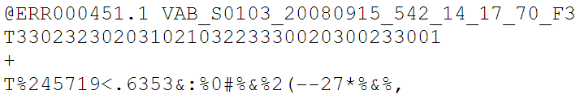
SOLiD output format(s)
CSFASTA
color-space sequence reads in a fasta format
These reads can be retained and analyzed in color-space by software
The Format Conversion Tool offers options for cleaning of the CSFASTA files
Notes:
SOLiD outputs CSFASTA. It’s a semi-raw format similar to FASTQ. Read starts with the first base, but colour calls follow.
NB! All the mentioned formats of the sequencers may be out of date with the current versions of the machines & software. Please refer to fresh documentation.

Slide 14
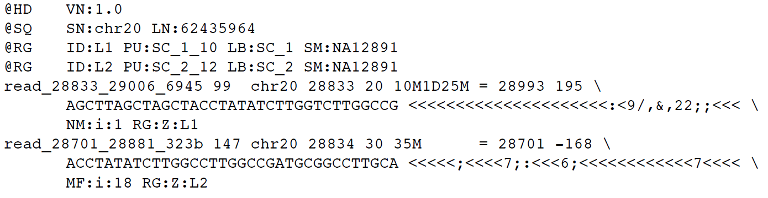
Common (“standard”) format for read alignments: Alignment/Assembly Format
SAM is a plain-textual format of the alignments (in a flavour that is similar but different to GFF or BED). It is luckily extensible.
BAM is a dedicated binary format including the compressed SAM. It enables fast access to data without having to “unzip” the whole file.
For the typically large data, BAM is currently the most recommended and most “standard” format.
Notes:
Read aligners output a number of more or less similar own formats. However many of them output data in the common SAM/BAM format, what is good news.

Slide 15
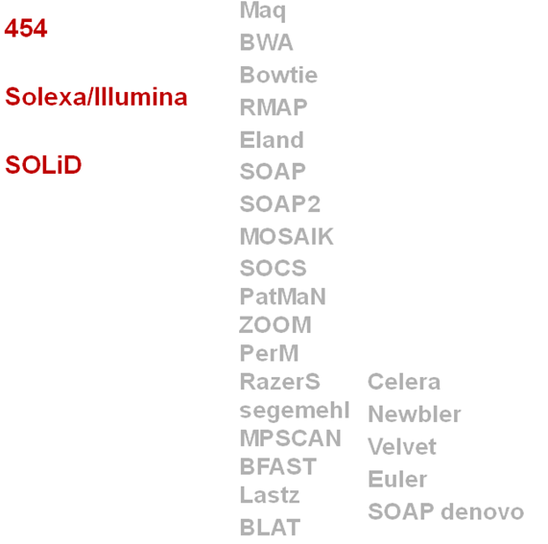
Sequencers & Sequence Assembly Packages

Slide 16
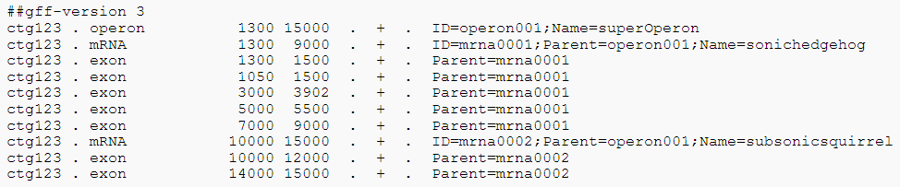
Formats for Genome/Gene annotation
BED format (genome-browser tracks)
GFF format (gene/genome features)
BioXSD (XML) (any annotation; under development)
Notes:
Genome & sequence annotation formats can store some of the diverse kinds of data resulting from a sequencing study.
BED format is a plain-text (tabular) format that can directly be displayed for example in the UCSC Genome Browser or similar.
GFF format, latest version GFF3. It’s a tabular plain-text format for genome or sequence annotation, can contain also the sequences, alignments, dependencies between features. Is extensible. Currently most recommended & quite “standard” format.
BioXSD is a new set of structured, “object-oriented” formats for exchange of sequence data, any kind of sequence/genome annotation, and related. It is under development and optimised for use with (but not limited to) Web services, and aims to becoming a standard format in future. Very generic and extensible thanks to the use of XML Schema (XSD).

Slide 17
Points to remember on Data Formats
For base-call data, “standard” FASTQ (Sanger, Phred)
For read alignments, SAM/BAM/MAQ format
For annotation results (e.g. GFF or BED format)
Notes:
17

Slide 18
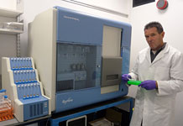
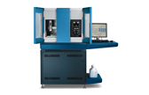
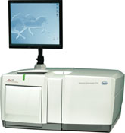
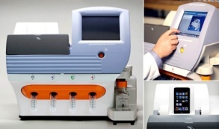
All platforms have errors
Illumina
SoLID/ABI-Life
Roche 454
Ion Torrent
Removal of low quality bases/ Low complexity regions
Removal of adaptor sequences
Homopolymer-associated base call errors (3 or more identical DNA bases) causes higher number of (artificial) frameshifts

Slide 19
Illumina artefacts
under represented GC rich regions
PCR
Sequencing
GGC/GCC motif is associated with low quality and mismatches
Low quality reads < 20% phred score

Slide 20
Need for QC & Preprocessing
QC analysis of sequence data is extremely important for meaningful downstream analysis
To analyze problems in quality scores/ statistics of sequencing data
To check whether further analysis with sequence is possible
To remove redundancy (filtering)
To remove low quality reads from analysis
To remove adapter contamination
Highly efficient and fast processing tools are required to handle large volume of datasets

Slide 21
Need for QC & Preprocessing
The quality of data is very important for various downstream analyses, such as sequence assembly, single nucleotide polymorphisms identification
Most of the programs available for downstream analyses do not provide the utility for quality check and filtering of NGS data before processing

Slide 22
NGS QC Toolkit & FastQC
NGS QC Toolkit is for quality check and filtering of high-quality read
This toolkit is a standalone and open source application freely available at http://www.nipgr.res.in/ngsqctoolkit.html
Application have been implemented in Perl programming language
QC of sequencing data generated using Roche 454 and Illumina platforms
Additional tools to aid QC : (sequence format converter and trimming tools) and analysis (statistics tools)
FastQC can be used only for preliminary analysis

Slide 23
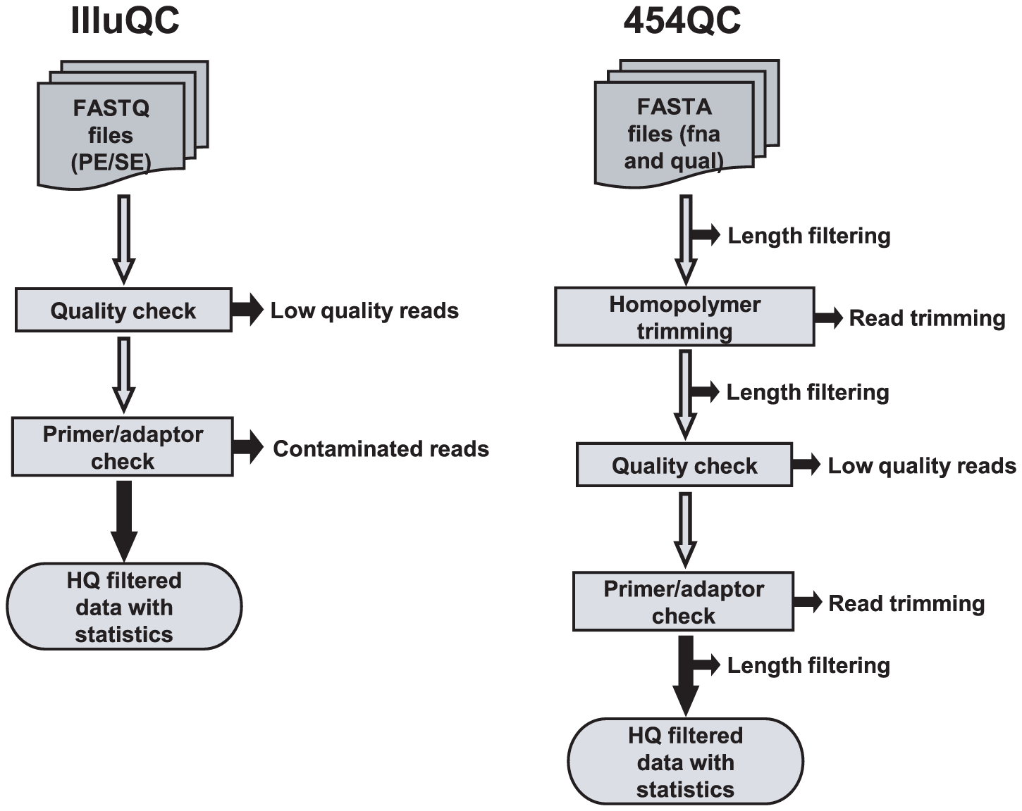

Slide 24
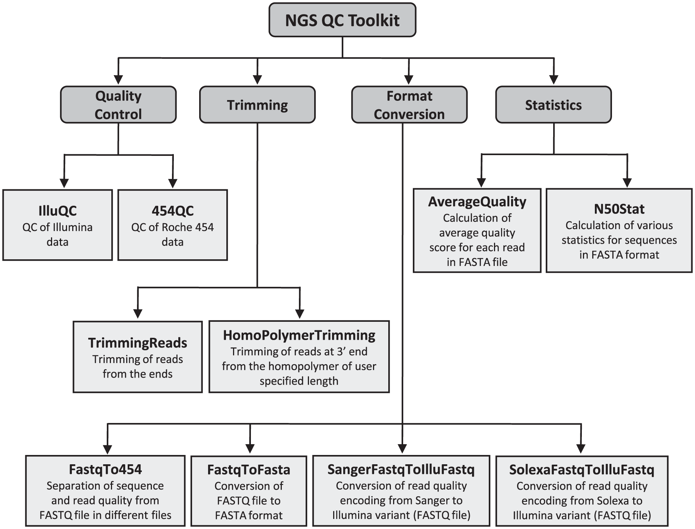

Slide 25
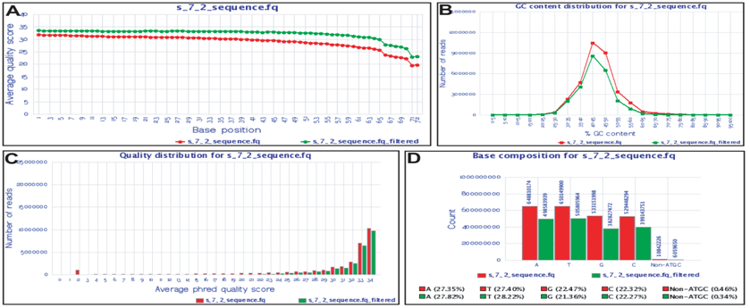
NGSQC toolkit Output

Slide 26
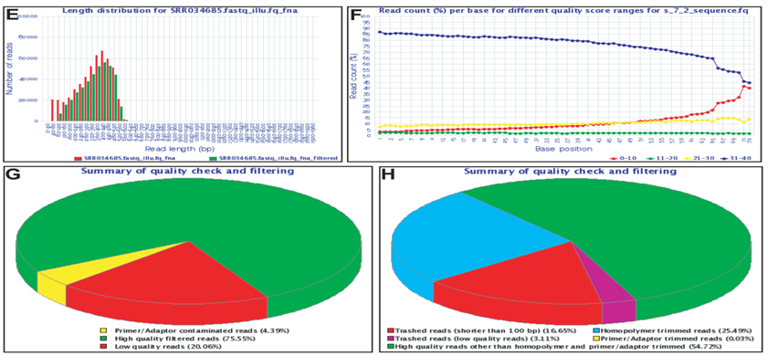
NGSQC toolkit Output

Slide 27
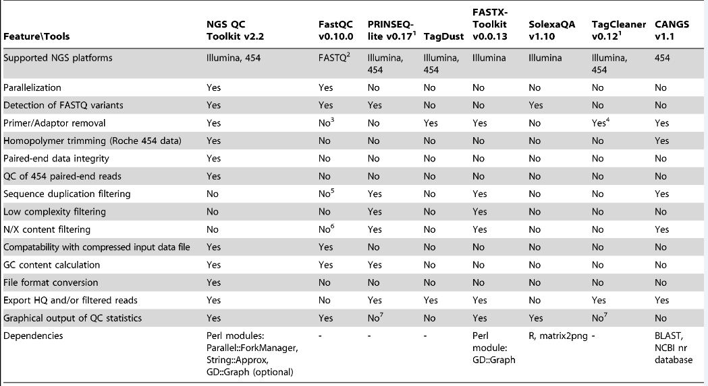
Comparison - QC tools

Slide 28
FastQC
Basic statistics
Quality- Per base position
Per Sequence Quality Distribution
Nucleotide content per position
Per sequence GC distribution
Per base GC distribution
Per base N content
Length Distribution
Overrepresented/ duplicated sequences
K-mer content

Slide 29
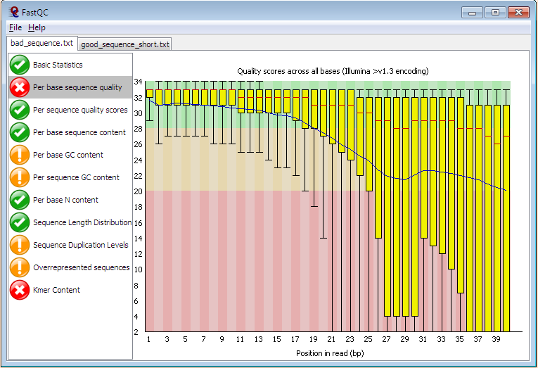
FastQC (Box-Whisker plot)
Y axis- Quality Score
X axis- Base position

Slide 30
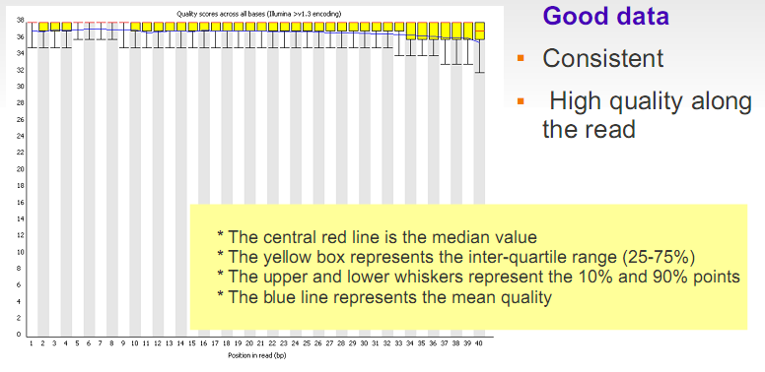
2. Quality- Per base position

Slide 31
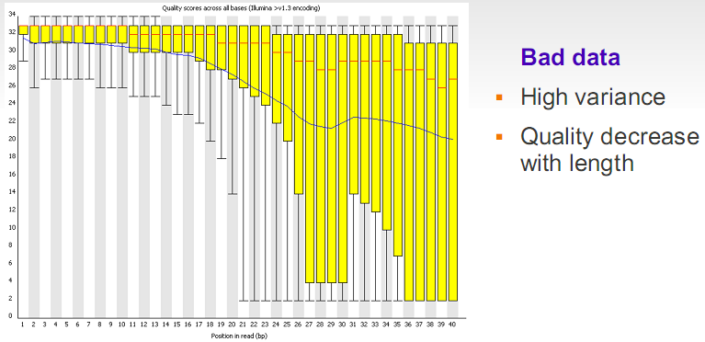
2. Quality- Per base position

Slide 32
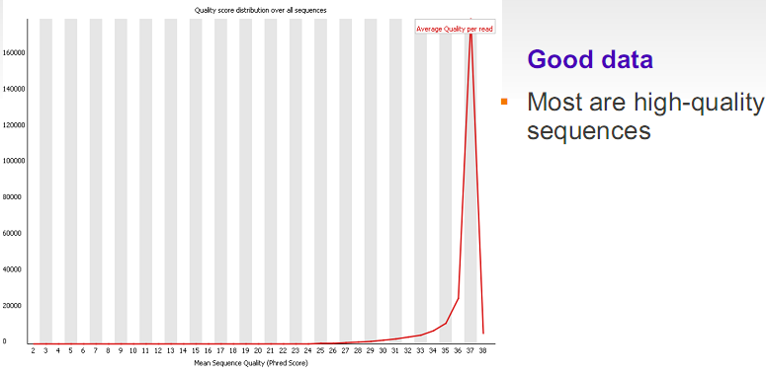
3.Per Sequence Quality Distribution

Slide 33
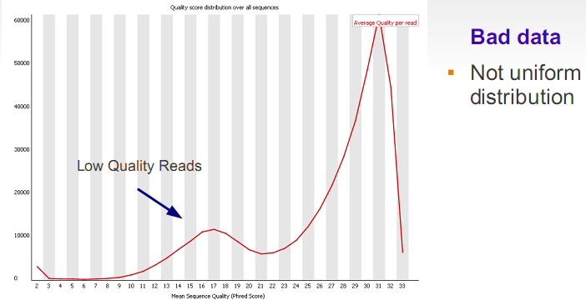
3. Per Sequence Quality Distribution

Slide 34
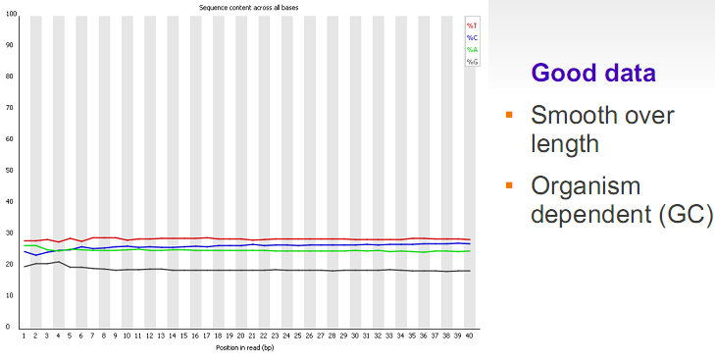
4.Nucleotide content per position

Slide 35
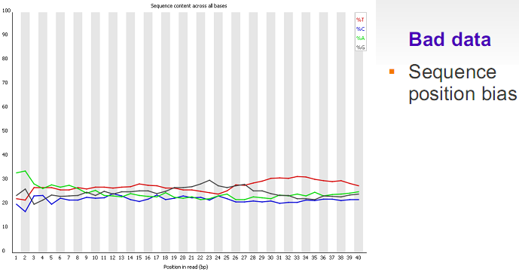
4. Nucleotide content per position

Slide 36
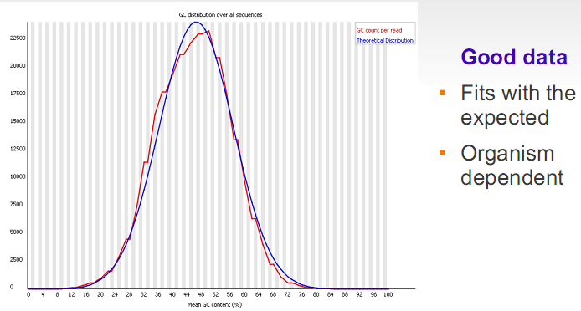
5.Per sequence GC distribution

Slide 37
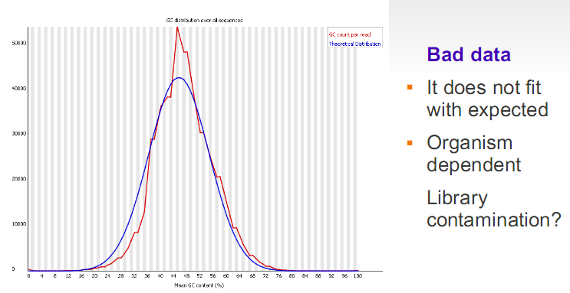
5.Per sequence GC distribution

Slide 38
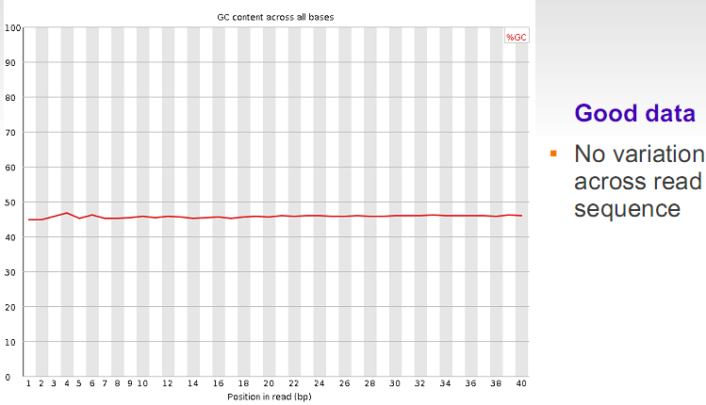
6. Per base GC distribution

Slide 39
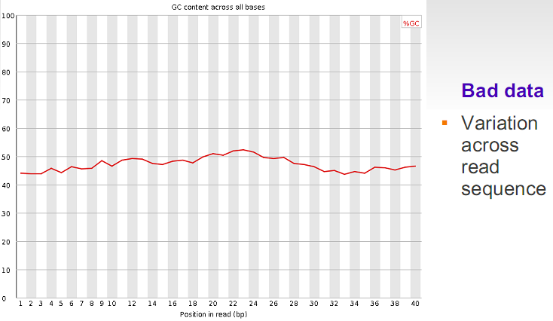
6. Per base GC distribution

Slide 40
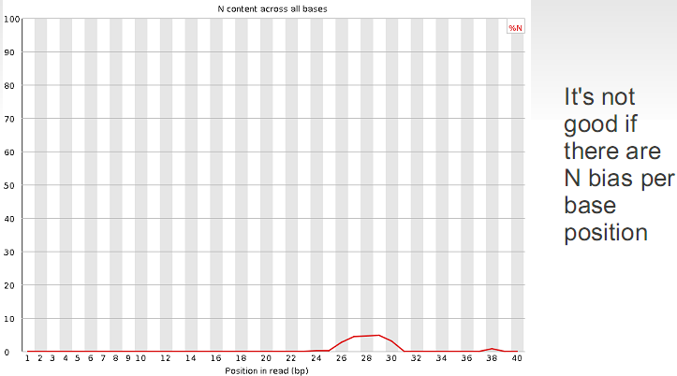
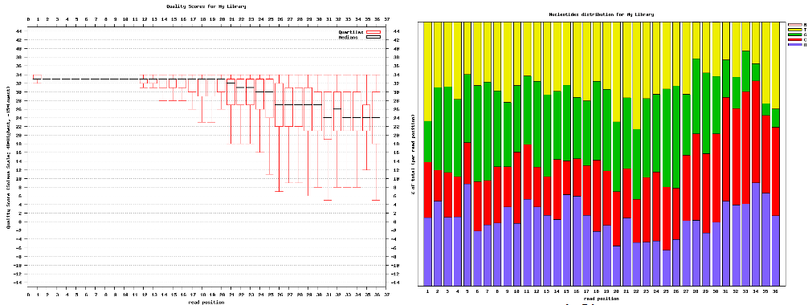
7. Per base N content

Slide 41
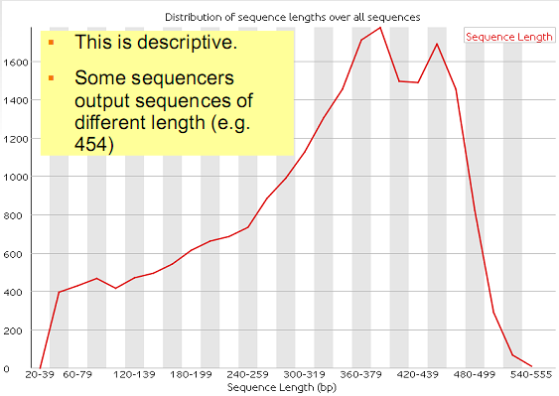
7. Length Distribution

Slide 42
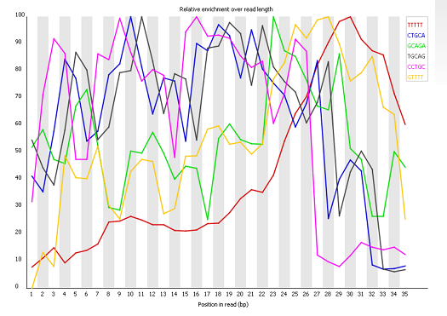
8. Kmer content
Any k-mer showing more than a 3 fold overall enrichment or a 5 fold enrichment at any given base position will be reported by this module.

Slide 43

9. Overrepresented/ duplicate sequences
The analysis of overrepresented sequences will spot an increase in any exactly duplicated sequences
Too many duplicate regions in the sequence will be due to sequencing problems
This module will issue a warning if any sequence is found to represent more than 0.1% of the total.

Slide 44
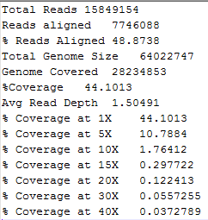
QC Report
Alignment statistics
Sequence Statistics
Total No. of Sequences 6970943
Avg. Sequence Length 54
Max Sequence Length 54
Min Sequence Length 54
Total Sequence Length 376430922
Total N bases 14254521
% N bases 3.78676
No of Sequences with Ns 278635
% Sequences with Ns 3.99709
Quality Statistics
Total HQ bases 334195496
%HQ bases 88.78
Total HQ reads 6350256
%HQ reads 91.0961

Slide 45
Preprocessing raw data
Removing technical artifacts
Adjusting biases
etc

Slide 46
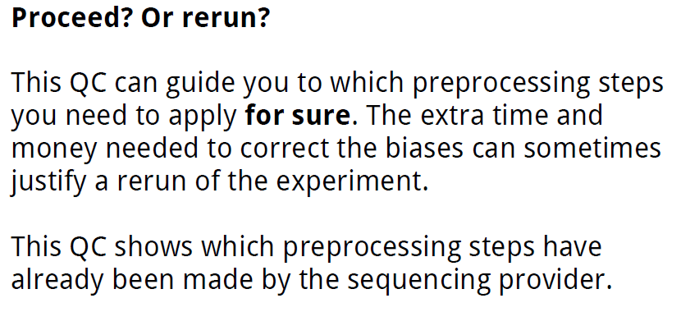
Quality control of raw data

Slide 47
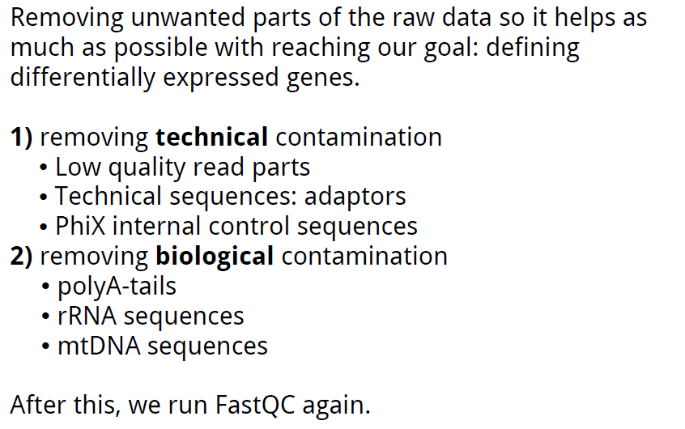
Preprocessing

Slide 48
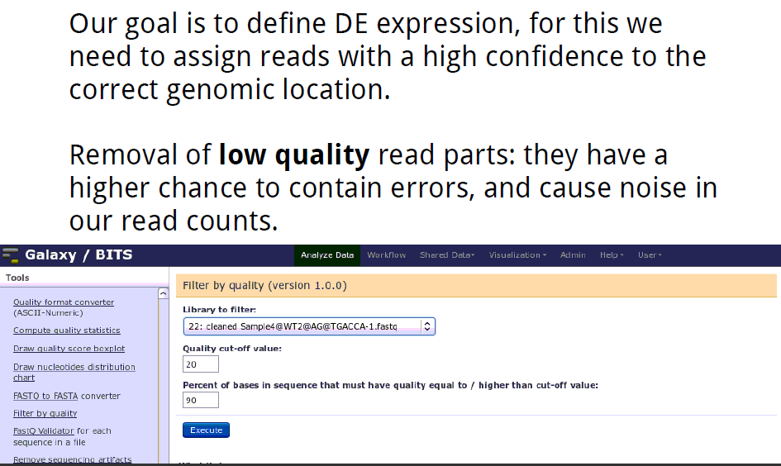
Technical contamination

Slide 49
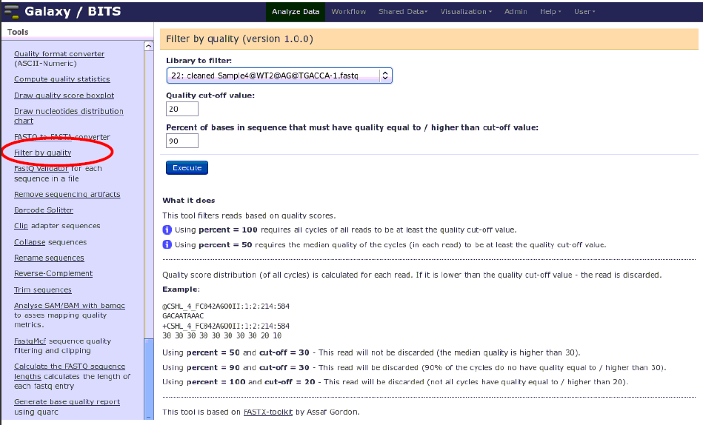
Removing low quality reads

Slide 50
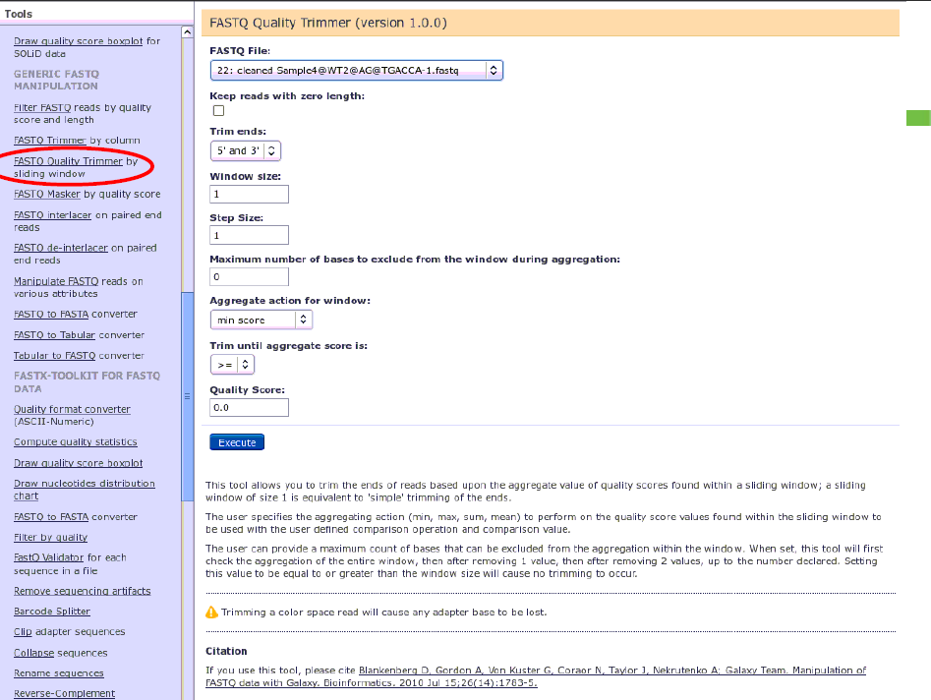
Trimming reads

Slide 51
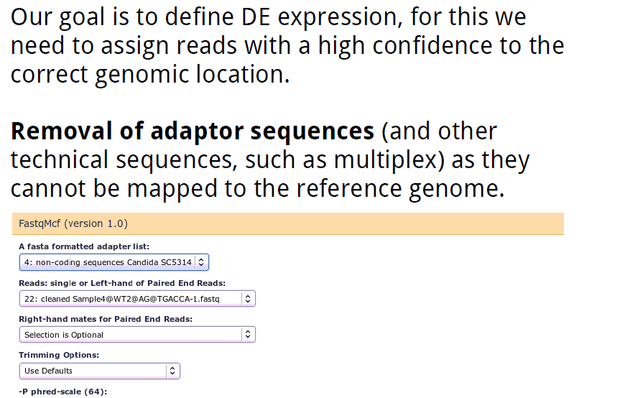
Technical contamination

Slide 52
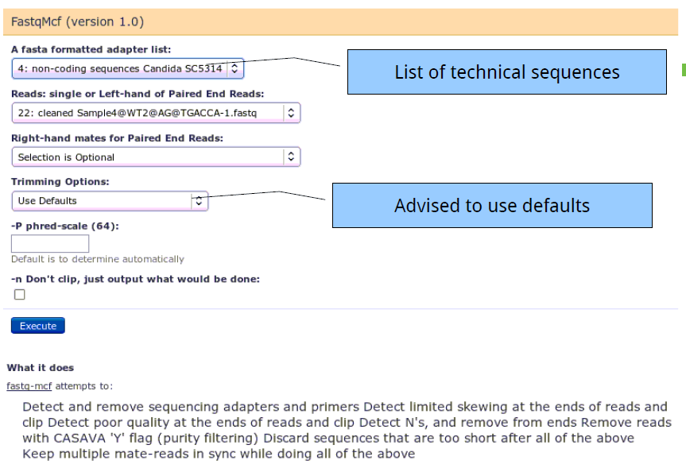
Remove adaptors & primers & etc

Slide 53
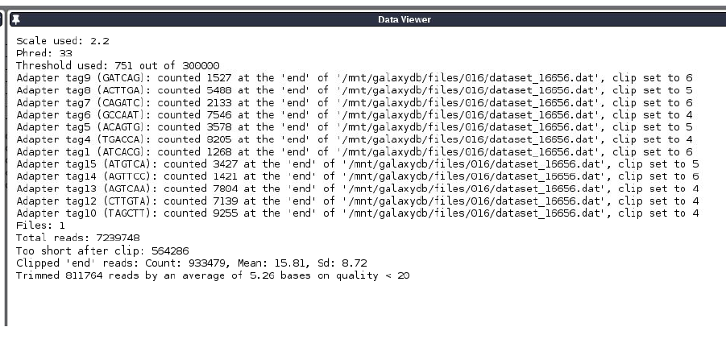
Fastq-mcf-output

Slide 54
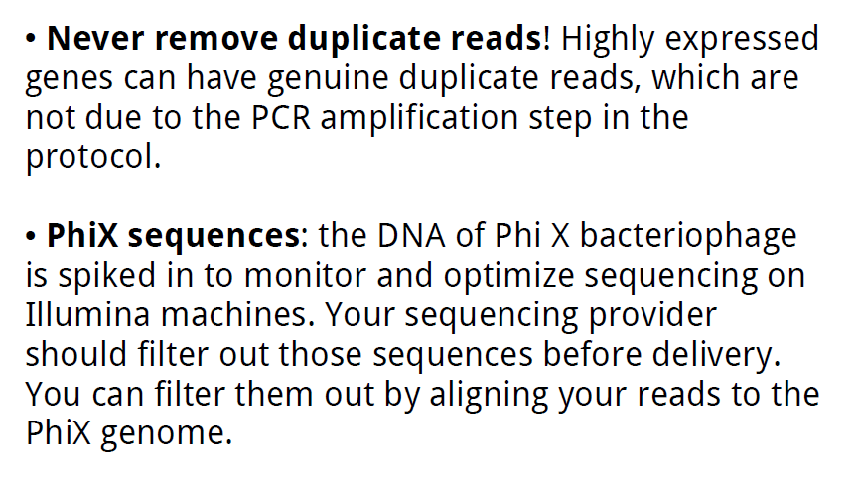
Technical contamination

Slide 55
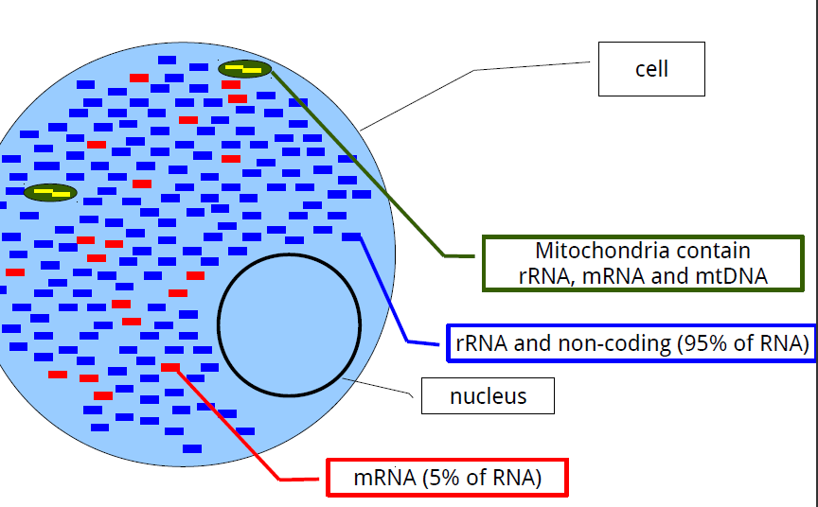
Biological contamination

Slide 56


Biological contamination

Slide 57

Biological contamination

Slide 58

Summary preprocessing

Slide 59
Acknowledgements
Part of these slides has been prepared borrowing material from other presentations.
I am particularly thankful to
Javier Santoyo
Joachim Jacob (VIB)
Karan Veer Singh (NBAGR)

